Slide 1
NAS
A peer to peer decentralized sharded file system
By Neil, Aakaash & Sutej

Slide 2




The Motivation
Why do we need a sharded distributed storage system?
Michael
Dwight
Pam
Oscar
Let's take the office as an example

Slide 3
Name : Michael
Age : 54
Job Title : Regional Manager
Job Description : Uses the internet mainly for browsing and doesn’t do anything useful
Amount of Storage Utilized : 2GB out of 100GB. 2%

Slide 4
Name : Dwight
Age : 33
Job Title : Assistant to the Regional Manager/Salesperson
Job Description : Makes costs and plays video games
Amount of Storage Utilized : 22GB out of 100GB. 22%

Slide 5
Name : Pam
Age : 26
Job Title : Receptionist/Office Manager
Job Description : Keeps track of Michael’s schedules and phone logs
Amount of Storage Utilized : 30GB out of 100GB. 30%

Slide 6
Name : Oscar
Age : 33
Job Title : Accountant
Job Description : Has data for every single transaction in the office and storage for all.
Amount of Storage Utilized : 96GB out of 100GB. 96%

Slide 7
Michael!!!
I’m running out of space!

Slide 8
The office does not have enough budget to buy external storage. How will they still store all their data?

Slide 9
They would use NAS
A peer to peer decentralized file system that focuses on efficient space usage.
All the files stored in each node will be split and distributed across all the nodes.
Each person would be able to access their own file whenever they want.
All communication between nodes is encrypted for security.
All nodes in the network will have their storage grow symmetrically.

Slide 11
Assumptions
Every node is always active.
Nodes are not malicious.
Maximum file size is smaller than the space available by the node with the smallest storage

Slide 12
Major Sections of NAS
Sharding
Ledgers
Encryption and Decryption
Locking
Load balancing
Reads
Writes
Communication

Slide 13
Communication – The setup
Each node on the network always has a server running on it which accepts requests.
Servers don’t make any requests, they only accept them.
Whenever the user interacts with the UI a temporary client is created.
The client uses the ledger to make connections with all the servers in the network.

Slide 14
Communication – Overview
No concept of master/slave, each node acts independently.
A node can send out requests for a file to be read or written to the network
Each node runs a server that supports multithreaded sockets for multiple requests at a time.

Slide 15
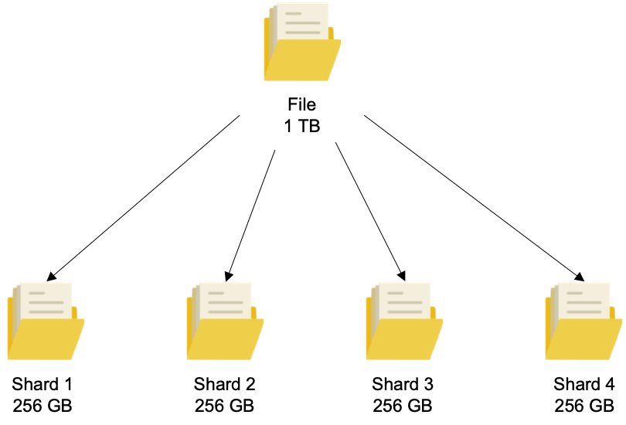
Sharding
Files are broken up into chunks and spread across the network.
Each chunk has a number associated to it based on where the IP is in the ledger.

Slide 16
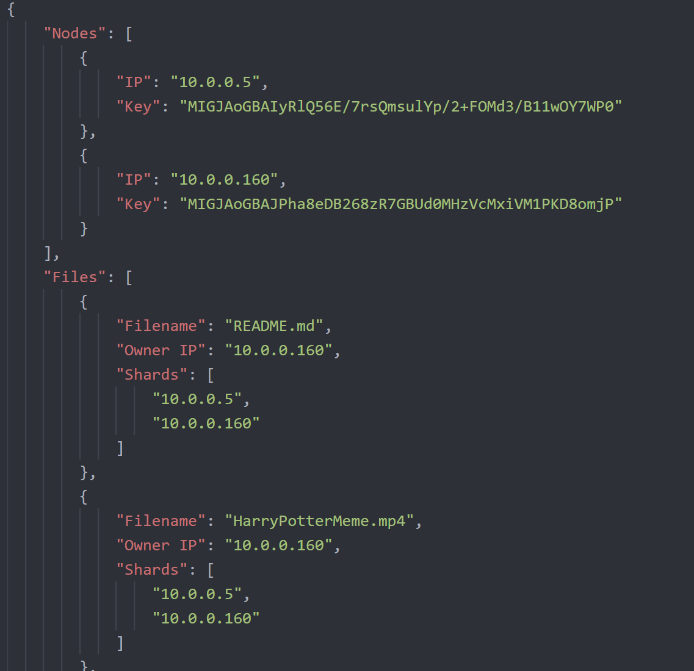
Ledgers
Usage of ledgers, which is a representation of the current state of the entire network.
Each node stores a copy of the ledger which is synchronized
Ledgers store the IP and public key of every other node as well as all the files stored across the network.

Slide 17
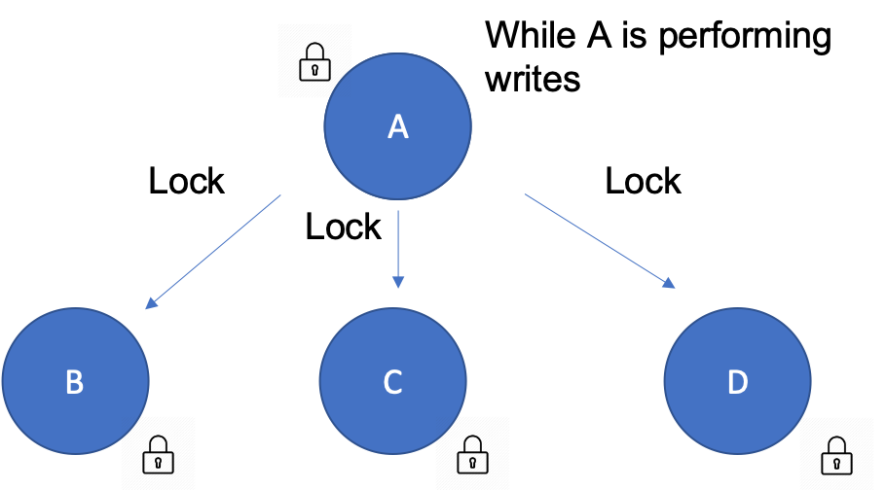
Locking
Each node has the capability to lock other nodes
Helps prevent inconsistencies while a write is occurring.

Slide 18
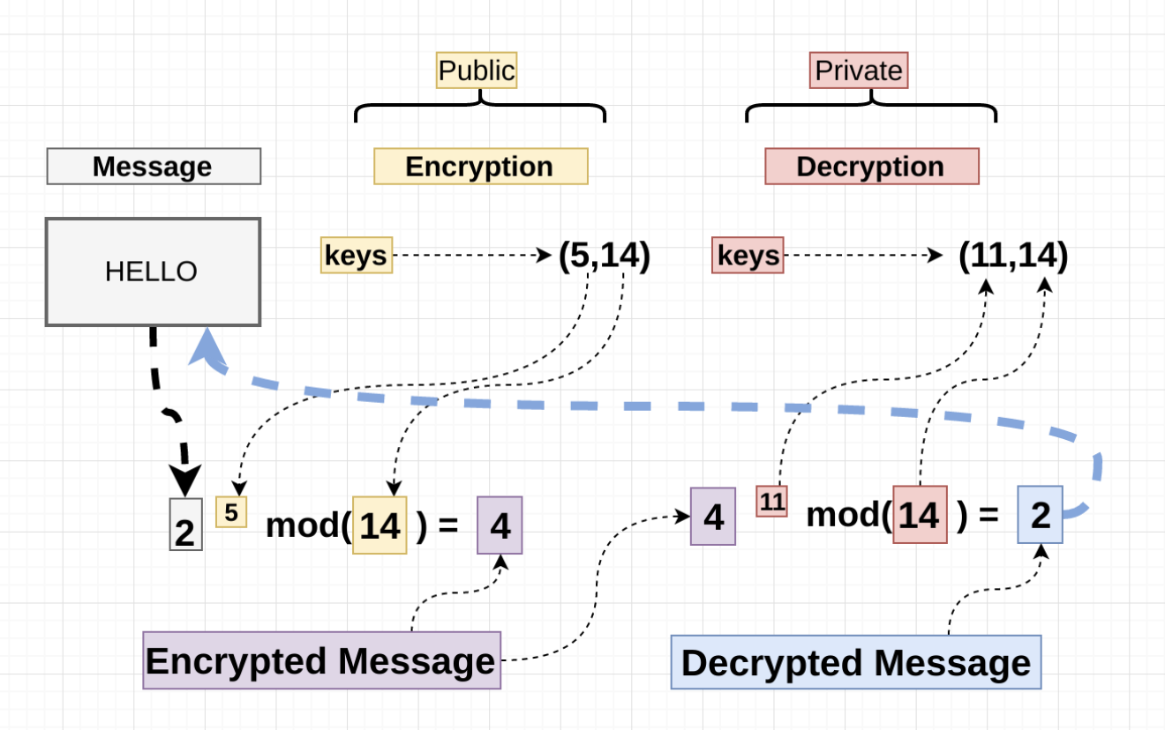
Encryption - Overview
All communication between nodes is encrypted.
We use the RSA python library to generate private and public keys for each node in the network.

Slide 19
How does Encryption/Decryption work?
We use a key size of 1024 bits i.e. 128 bytes(public and private keys)
The private key created for a node is stored locally on the system
The public key created for the node is stored in the ledger
A message is encrypted using a public key before sending it across the network.
A message is decrypted using a private key by the node, which is not shared with anyone else.

Slide 20
Encryption – A major bottleneck
So with RSA, the message size that we plan to encrypt should be equal to or lesser than our key size, this is a major problem
How do we resolve this?
We divide the files that we plan to send over our network into chunks of 128 bytes(key size), so that we can encrypt them, and then join them and send them over the network
RSA is slow/compute intensive compared to symmetric encryption, especially for decryption, and thus becomes a computational bottleneck
Advised to use a different encryption/decryption algorithm for large file data transfers

Slide 21
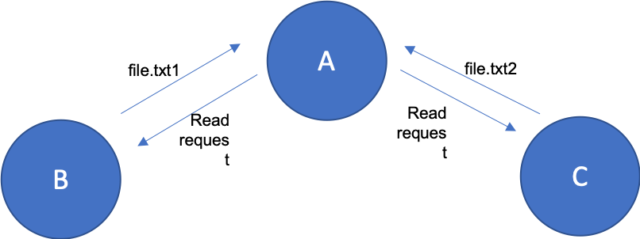
Reads - Overview
Reads occur whenever the user wants to get the file locally to open and make changes.
Reads can occur even when servers are locked.
Every node gets the same information on read, since if a client is writing then it cannot read at the same time

Slide 22
How exactly do reads work?
A client sends out a read request for a file to all the servers one at a time.
The servers check whether the client owns the file
If yes, the servers will encrypt the file data using their own public key and send it to the requesting client.
This file is then decrypted on the client's end using its own private key.
If no, server will indicate that this file is not owned by this client

Slide 23
Reads – Critical points to remember
Reads can occur at the same time a write is happening.
Ledger updates are not required during a read operation since the client is Requesting for its own file.

Slide 24
Writes - Overview
Writes occur when someone creates/adds a file to the network.
File gets sharded and distributed.
All nodes are locked during writes.

Slide 25
How exactly do writes work?
When a client wants to write, it starts by locking each server in the network, to prevent multiple writes from occurring at the same time.
The contents of a file(which is meant to be added to the network) are broken up into as many chunks as the number of nodes in the system
One of the chunks is stored locally in the client’s system in the “directory” folder, which is accessible to the client
The other chunks are encrypted and sent across all the other nodes in the network , these nodes will store these chunks in their local “fico” directory

Slide 26
Writes – Critical points to remember
When a write is occurring, the client will lock all the servers in the network, this prevents write inconsistencies
Whenever a write occurs the client will broadcast an updated ledger to all the other nodes ensuring consistency

Slide 27

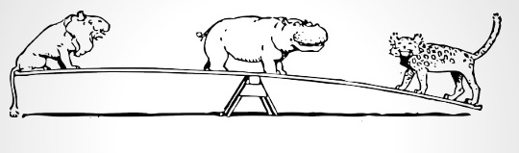
Load Balancing
Method used to redistribute sharded files across the network.
Needed whenever the number of nodes in the network changes.
Makes sure that storage growth requirements are still symmetric.

Slide 28

Load Balancing Procedure
Client calls load-balance request to all servers one at a time.
After a server receives a request it creates a client one at a time to get each of its files from all the servers.
After a server gets all its files locally, it redistributes each file one by one.
After the redistribution it sends a confirmation to the original client confirming load balance.
Then, the client proceeds with sending requests to all other servers till every single server has redistributed its file successfully

Slide 29
Load Balancing Assumptions
Load Balancing is a time-consuming process and it should only happen at a low traffic time.
The UI does not have a load balancing option to avoid overuse of this command.
The command line would be used to do the load balancing.
And this should either be done weekly or manually by designated personnel.

Slide 30
NAS GUI
NAS GUI has been implemented using PyQt5

Slide 31
NAS GUI Network Options
NAS GUI gives the user two options
‘Create my network’
Starts a new network by creating a new ledger on the system which holds the IP address and public key of the current system.
Creates and stores public and private keys for the system needed for encryption
‘Join the network’
User can join a pre-existing NAS network by entering in the IP address and public key of a node currently in the network

Slide 32
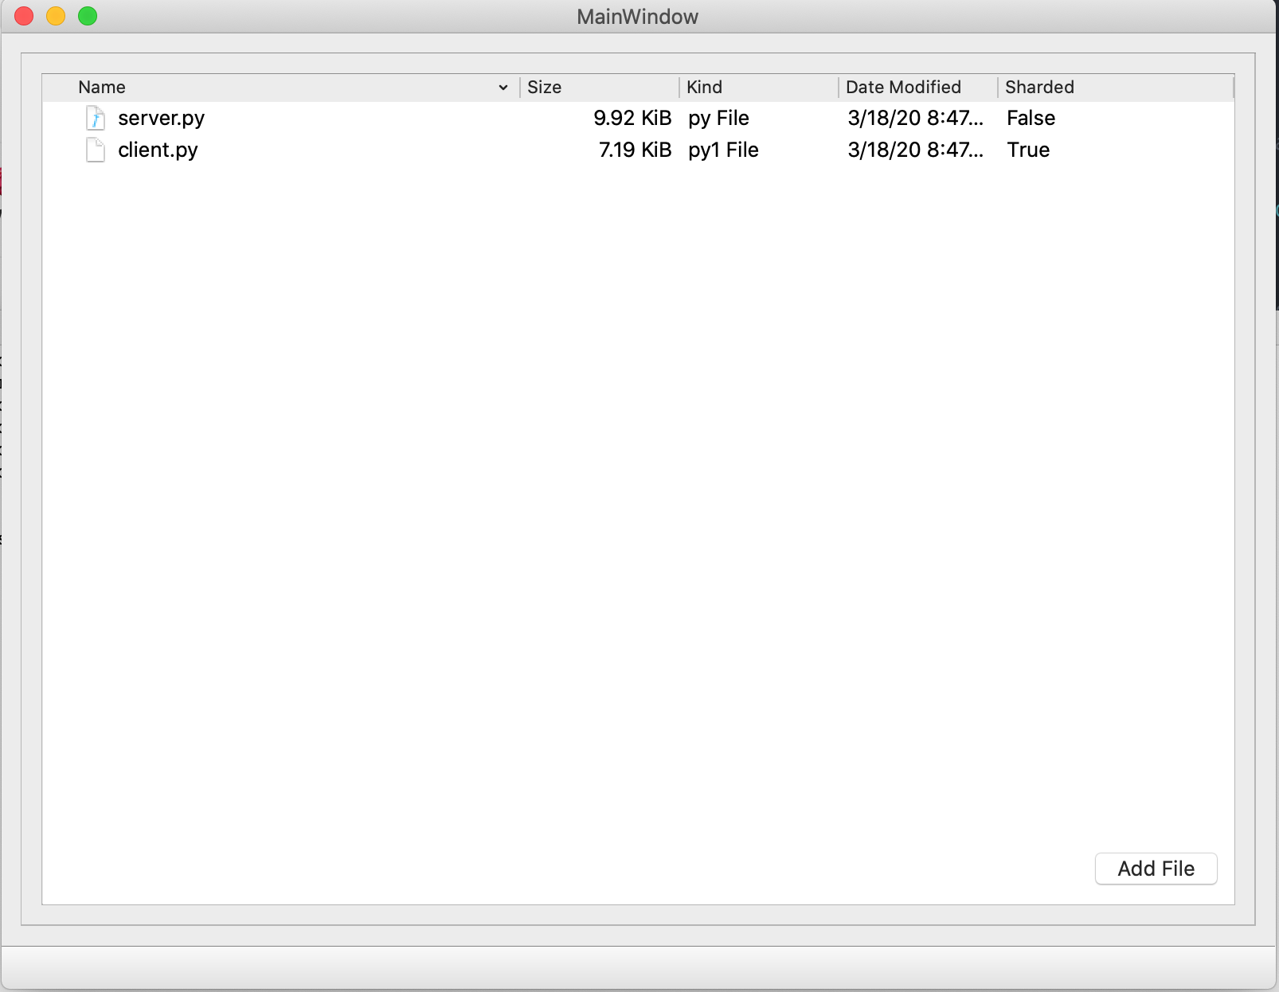
NAS File Browser
Simple File System GUI created using PySide

Slide 33
NAS File Browser
Once the user has connected to the NAS network, the NAS File Browser will open automatically
This GUI enables a user to add files to the NAS network/pull files from the NAS network
When we “add a file” from our local file system to the NAS network, it will automatically get sharded and sent across all the nodes in the network
When we want to retrieve the complete file, we can “pull the file” from the other nodes and access the complete file on our system

Slide 34
Features Implemented
Designed a peer to peer decentralized file system that focuses on efficient space usage
Implemented sharding by means of which, files can be split and distributed across the network
Successfully created and used ledgers, to prevent attacks from outside the network
Each node in the network can access its own file whenever it wants
Read and write operations are supported to each of the files present in the network
Able to achieve locking of servers to prevent write inconsistencies
Network supports multithreaded sockets for multiple requests to a node at the same time
All communication between nodes is encrypted for security
All nodes in the network will have their storage grow symmetrically
Can successfully add more nodes to the network, without compromising the integrity of the network
Can successfully redistribute sharded files across the network through the technique of load balancing

Slide 35
Results - Quantitative
File Size | Encryption | Time in seconds | Total Space Used in the network
500KB | No | < 1 second | 500KB
500KB | Yes | ~ 1 second | 745KB
10MB | No | 12 seconds | 10MB
10MB | Yes | 23 seconds | 17MB
100MB | No | 243 seconds | 100MB
100MB | Yes | 467 seconds | 164MB
These write tests were run on 3 nodes on both Windows and Mac Systems.
The internet speed of the network is 22MBps
Time is taken as an average after 5 iterations of running on the same files

Slide 36
Results - Qualitative
Based on the real speed of the network writes across the network are fast.
Using encryption the speed as well as the storage is not used efficiently
To improve results a better encryption model can be used.

Slide 37

Thank You

